Slide 1
GRAPIHCS AND PHP

Slide 2
INTRODUCTION
The Web is more than just text.
Images appear in the form of logos, buttons, photographs, charts, advertisements, and icons.
Many of these images are static and never change, built with tools such as Photoshop.
PHP supports graphics creation with the built-in GD extension.

Slide 3
To embed a PHP-generated image in an HTML page, imagine that the PHP script that generates the image is actually the image.
Thus, if we have image1.php and image2.php scripts that create images.
<html>
<head>
<title>Example Page</title>
</head>
<body>
This page contains two images.
<img src="image1.png" alt="Image 1" />
<img src="image2.png" alt="Image 2" />
</body>
</html>
<html>
<head>
<title>Example Page</title>
</head>
<body>
This page contains two images.
<img src="image1.php" alt="Image 1" />
<img src="image2.php" alt="Image 2" />
</body>
</html>
Instead of referring to real images on your web server, the img tags now refer to the PHP scripts that generate and return image data.

Slide 4
BASIC GRAPHICS CONCEPTS
An image is a rectangle of pixels of various colors. Colors are identified by their position in the palette, an array of colors.
Each entry in the palette has three separate color values—one for red, one for green, and one for blue.
Each value ranges from 0 (this color not present) to 255 (this color at full intensity).
Image files are rarely a straightforward dump of the pixels and the palette.
Instead, various file formats (GIF, JPEG, PNG, etc.) have been created that attempt to compress the data somewhat to make smaller files.
Different file formats handle image transparency, which controls whether and how the background shows through the image, in different ways.

Slide 5
Anti-aliasing is where pixels at the edge of a shape are moved or recolored to make a gradual transition between the shape and its background.
With 256 possible values for each of red, green, and blue, there are 16,777,216 possible colors for each pixel.
Some file formats limit the number of colors you can have in a palette (e.g., GIF supports no more than 256 colors).
Others allows as many colors as we need. These are known as true color formats, because 24-bit color (8 bits for each of red, green, and blue) gives more varieties than the human eye can distinguish.

Slide 6
CONTENT-TYPE VALUES
GIF image/gif
JPEG image/jpeg
PNG image/png
WBMP image/vnd.wap.wbmp
If we are writing code that must be portable across systems that may support different image formats, use the imagetypes() function to check which image types are supported.
This function returns a bit field; you can use the bitwise AND operator (&) to check if a given bit is set.
The constants IMG_GIF, IMG_JPG, IMG_PNG, and IMG_WBMP correspond to the bits for those image formats.

Slide 7
BASIC DRAWING FUNCTIONS
imagesetpixel(image, x, y, color)
  Imagesetpixel( ) sets the color of a specified pixel.
Functions for drawing lines
  imageline(image, start_x, start_ y, end_x, end_ y, color);
  imagedashedline(image, start_x, start_ y, end_x, end_ y, color);
Functions for drawing rectangles
  imagerectangle(image, tlx, tly, brx, bry, color);
  imagefilledrectangle(image, tlx, tly, brx, bry, color);
Functions for drawing polygons
  imagepolygon(image, points, number, color);
  imagefilledpolygon(image, points, number, color);

Slide 8
)
Functions for drawing arcs
  imagearc(image, center_x, center_ y, width, height, start, end, color);
  imagefilledarc (imagearc(image, center_x, center_ y, width, height, start, end, color , style)
Functions for filling in already-drawn shapes
  imagefill(image, x, y, color);
  imagefilltoborder(image, x, y, border_color, color);
Functions to draw ellipse
  imageellipse (image ,center_x ,center_y, width , height ,color)
Functions to rotate an image by an arbitrary angle
  imagerotate(image, angle, background_color);
Value | Meaning
IMG_ARC_PIE | draws a filled wedge shape with a curved edge
IMG_ARC_CHORD | draws a straight line between the starting and ending angles
IMG_ARC_NOFILL | draws the outside edge line without drawing the two lines toward the center of the arc
IMG_ARC_EDGED | draws an unfilled wedge shape with a curved edge

Slide 9
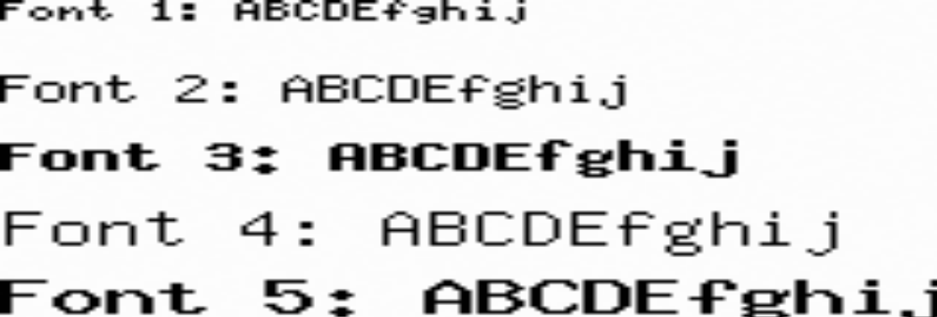
WORKING WITH FONTS
GD identifies fonts by an ID. Five fonts are built-in, and you can load additional fonts through the imageloadfont() function.

Slide 10
IMAGES WITH TEXT

Slide 11
Imagecreate(height,width)
imagefilledrectangle ( resource $image , int $x1 , int $y1 , int $x2 , int $y2 , int $color )
x1: x coordinate for point 1, y1: y coordinate for point 1.
x2: x coordinate for point 2, y2: y coordinate for point 2.
imagettftext ( resource $image , $size , $angle , $x , $y , $color , $fontfile , $text ).
The angle in degrees, with 0 degrees being left-to-right reading text. Higher values represent a counter-clockwise rotation. For example, a value of 90 would result in bottom-to-top reading text.

Slide 12

Example : Adding text to an image
<?php
$im = ImageCreate(200,200);
$white = ImageColorAllocate($im,0,0,0);
$black = ImageColorAllocate($im,255,255,255);
ImageFilledRectangle($im,50,50,150,150,$black);
ImageString($im,5,50,160,"A Black Box",$black);
Header('Content-Type: image/png');
ImagePNG($im);
?>
Output:

Slide 13
FONTS IN PHP
Five fonts are built-in, and you can load additional fonts through the imageloadfont() function.
TrueType is an outline font standard; it provides more precise control over the rendering of the characters.
To add text in a TrueType font to an image, use imagettftext()
imagettftext(image, size, angle, x, y, color, font, text)

Slide 14
True Type Fonts:
To add text in a TrueType font to an image, use ImageTTFText( ):
ImageTTFText(image, size, angle, x, y, color, font, text);
Example:
<?php
$im = ImageCreate(350, 70);
$white = ImageColorAllocate($im, 0xFF,0xFF,0xFF);
$black = ImageColorAllocate($im, 0x00,0x00,0x00);
ImageTTFText ($im, 20, 0, 10, 40, $black, 'courbi', 'The Courier TTF font');
header('Content-Type: image/png');
ImagePNG($im);
?>
Output:

Slide 15
Angle= The angle in degrees, with 0 degrees being left-to-right reading text. Higher values represent a counter-clockwise rotation. For example, a value of 90 would result in bottom-to-top reading text.
x=The coordinates given by x and y will define the basepoint of the first character (roughly the lower-left corner of the character). This is different from the imagestring(), where x and y define the upper-left corner of the first character. For example, "top left" is 0, 0.
y=The y-coordinate. This sets the position of the fonts baseline, not the very bottom of the character.

Slide 16
DYNAMICALLY GENERATED BUTTONS
Creating images for buttons on the fly is one popular use for generating images.
This involves compositing text over a preexisting background image.
<?php
$font = "times";
$size = isset($_GET['size']) ? $_GET['size'] : 12;
$text = isset($_GET['text']) ? $_GET['text'] : '';
$image = imagecreatefrompng("button.png");
$black = imagecolorallocate($image, 0, 0, 0);

Slide 17
if ($text) {
// calculate position of text
$tsize = imagettfbbox($size, 0, $font, $text);
$dx = abs($tsize[2] - $tsize[0]);
$dy = abs($tsize[5] - $tsize[3]);
$x = (imagesx($image) - $dx ) / 2;
$y = (imagesy($image) - $dy ) / 2 + $dy;
// draw text
imagettftext($image, $size, 0, $x, $y, $black, $font, $text);
}
header("Content-Type: image/png");
imagepng($image);
?>

Slide 18
SCALING IMAGES

Slide 19
There are two ways to change the size of an image.
ImageCopyResized( ) function and ImageCopyResampled( ) functions can be used. Both functions take the same arguments:
ImageCopyResized(dest, src, dx, dy, sx, sy, dw, dh, sw, sh);
ImageCopyResampled(dest, src, dx, dy, sx, sy, dw, dh, sw, sh);
The dest and src parameters are image handles. The point (dx,dy) is the point in the destination image where the region will be copied. The point (sx,sy) is the upperleft corner of the source image. The sw, sh, dw, and dh parameters give the width and height of the copy regions in the source and destination.

Slide 20
The imagecopyre
sampled() function is slower, but features pixel interpolation to give smooth edges and clarity to the resized image
The imagecopyresized() function is fast but crude, and may lead to jagged edges in your new images.

Slide 21
Resizing with ImageCopyResampled( )
<?php
$src = ImageCreateFromJPEG('php.jpg');
$width = ImageSx($src);
$height = ImageSy($src);
$x = $width/2; $y = $height/2;
$dst = ImageCreateTrueColor($x,$y);
ImageCopyResampled($dst,$src,0,0,0,0,$x,$y,$width,$height);
header('Content-Type: image/png');
ImagePNG($dst);
?>

Slide 22
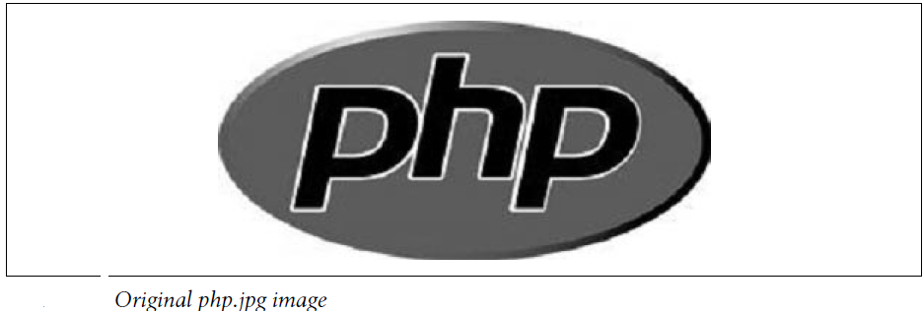
Lets take the php.jpg image

Slide 23

Output:

Slide 24
COLOR HANDLING

Slide 25
To create a true color image, use the ImageCreateTrueColor( ) function:
$image = ImageCreateTrueColor(width, height);
Use ImageColorResolveAlpha( ) to create a color index that includes transparency:
$color = ImageColorResolveAlpha(image, red, green, blue, alpha);
The alpha value is between 0 (opaque) and 127 (transparent).

Slide 26
A simple orange ellipse on a white background
<?php
$im = ImageCreateTrueColor(150,150); //(w,h)
$white = ImageColorAllocate($im,255,255,255); //(r,g,b)
ImageAlphaBlending($im, false);
ImageFilledRectangle($im,0,0,150,150,$white); //(x1,y1,x2,y2)
$red = ImageColorResolveAlpha($im,255,50,0,50); //(r,g,b,alpha)
ImageFilledEllipse($im,75,75,80,63,$red); //(x,y,w,h,c)
header('Content-Type: image/png');
ImagePNG($im);
?>

Slide 27

Output:
An Orange Ellipse on a white Background

Slide 28
Using Alpha Channel:
Alpha blending is a toggle that determines whether the alpha channel, if present, should be applied when drawing.
If alpha blending is off, the old pixel is replaced with the newpixel.
If an alpha channel exists for the newpixel, it is maintained, but all pixel information for the original pixel being overwritten is lost.
Next Example illustrates alpha blending by drawing a gray rectangle with a 50% alpha channel over an orange ellipse.

Slide 29
A gray rectangle with a 50% alpha channel overlaid
<?php
$im = ImageCreateTrueColor(150,150);
$white = ImageColorAllocate($im,255,255,255);
ImageAlphaBlending($im, false);
ImageFilledRectangle($im,0,0,150,150,$white);
$red = ImageColorResolveAlpha($im,255,50,0,63);
ImageFilledEllipse($im,75,75,80,50,$red);
$gray = ImageColorResolveAlpha($im,70,70,70,63);
ImageAlphaBlending($im, false);
ImageFilledRectangle($im,60,60,120,120,$gray);
header('Content-Type: image/png');
ImagePNG($im);
?>

Slide 30


Output when Alpha Blending is Turned off.
Output: To enable alpha blending set ImageFilledRectangle( ) to true.
A gray rectangle over the orange ellipse.
Image with alpha blending enabled
Notes:
Image with alpha blending enabled

Slide 31
INDENTIFYING COLORS

Slide 32
To check the color index for a specific pixel in an image, use ImageColorAt( ):
$color = ImageColorAt(image, x, y);
For images with an 8-bit color palette, the function returns a color index that you then pass to ImageColorsForIndex( ) to get the actual RGB values:
$values = ImageColorsForIndex(image, index);
The array returned by ImageColorsForIndex( ) has keys "red", "green", and "blue".
If you call ImageColorsForIndex( ) on a color from a true color image, the returned array has an extra key, "alpha".

Slide 33
SCALING IMAGES

Slide 34
Read the original image with imagecreatefromjpeg()
$source_image = imagecreatefromjpeg("osaka.jpg");
Get the size of the original image: getimagesize() vs. imagesx() and imagesy()
$source_image = imagecreatefromjpeg("osaka.jpg");
$source_image_size = getimagesize("osaka.jpg");
The problem with the getimagesize() function is that it needs to reopen the file to get the actual image size.

Slide 35
Since you already have the image loaded with imagecreatefromjpeg() there is no need to load it again:
$source_image = imagecreatefromjpeg("osaka.jpg");
$source_imagex = imagesx($source_image);
$source_imagey = imagesy($source_image);
Create the destination image: imagecreate() vs. imagecreatetruecolor()
There are two PHP functions which can be used to create an image: imagecreate() and imagecreatetruecolor(). The first creates a palette based image (with a maximum of 256 different colors), and the second one creates a true color image (with a maximum - of 256*256*256 = 16 million colors).

Slide 36
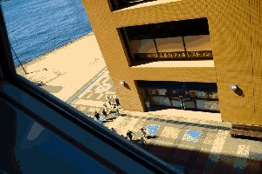
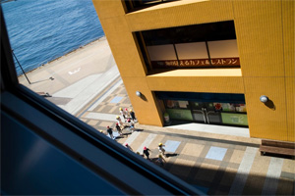
Imagecreate()
Imagecreatetruecolor()

Slide 37
So let's decide to use imagecreatetruecolor() and define a target size of 300x200 pixels:
$dest_imagex = 300; $dest_imagey = 200;
$dest_image = imagecreatetruecolor($dest_imagex, $dest_imagey);
Scale the image: imagecopyresized() vs. imagecopyresampled()
imagecopyresized() and imagecopyresampled(). The first one uses a very simple algorithm to scale the image, it's fast but the quality is really poor. The second one uses a better, but slower algorithm, resulting in a very high quality image.
imagecopyresized($dest_image, $source_image, 0, 0, 0, 0, $dest_imagex, $dest_imagey, $source_imagex, $source_imagey);
imagecopyresampled($dest_image, $source_image, 0, 0, 0, 0, $dest_imagex, $dest_imagey, $source_imagex, $source_imagey);

Slide 38
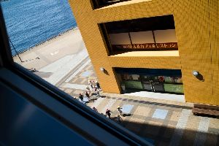

resized
resampled

